Slide 1
Naming Convention
Naming Convention
Naming Namespaces
NAMING Classes and members
Naming Variables AND Constants
Naming Interfaces
Notes:
Click through to the next slide…

Slide 2
Learning Objectives and Overview
After completing this learning unit, you should be able to :
In this section, we will discuss the following
Click Here
Name a namespace.
Name class and its members.
Name a variable and constant.
Name an interface.
Use the naming conventions to give names.
What are the different naming conventions?
How to name a namespace?
How to name a class and its members?
How to name a variable and a constant?
How to name an interface?
Click for Next Slide
Notes:
Course or Module Title
2
Date or Rev. #
Our objective here is to understand the importance of Polymorphism in Java and the ways we are going to implement it in Java.
After doing the practice exercises included in this section, you should be able to include polymorphism concept wherever it is appropriate to your code.
Excellere Restricted

Slide 3
Naming Convention

Slide 4

Why Naming Convention?
A naming convention or pattern is one of the most important elements of a code.
Understanding of the naming guidelines will eliminate unclear code and make it easier for developers to understand the code.

Slide 5

What are the Defined Capitalization Styles?
Pascal case: The first letter in the identifier and the first letter of each subsequent concatenated word are capitalized.
Pascal casing is usually used for naming classes.
Example: BackColor, Xvalue.
Camel case: The first letter of an identifier is lowercase and the first letter of each subsequent concatenated word is capitalized.
Camel casing is usually used for naming methods.
Example: numberOfDays, isValid.
Upper case: All letters in the identifier are capitalized.
Upper cases can be used for class constants.
Example: ID, PI.

Slide 6
Naming Namespaces

Slide 7
Guidelines for Naming Namespaces
The general rule for naming namespaces is to use the company name followed by the technology name and optionally the feature and design.
Syntax: CompanyName.TechnologyName[.Feature][.Design]
Prefixing namespace names with a company name or other well-established brand avoids the possibility of two published namespaces having the same name.
Use a stable, recognized technology name at the second level of a hierarchical name.
Example: com.pacific.Banking, System.Web.UI, System.Windows.Forms

Slide 8
Naming Classes and Members

Slide 9
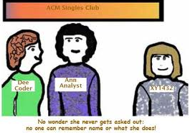
Naming Guidelines for Classes
Use a noun or noun phrase to name a class.
Use pascal case.
A class name should not start with numeric value but can end with numeric value.
Do not use a type prefix, such as C for class.
Do not use the hyphen character (-).
To use a keyword to name a member, prefix it with an underscore ’_’.
Example: FileStream, Button.

Slide 10
Naming Guidelines for Methods
Use verbs or verb phrases to name methods.
Use pascal case.
Example: RemoveAll(), GetCharAt().

Slide 11
Naming Variables and Constants

Slide 12
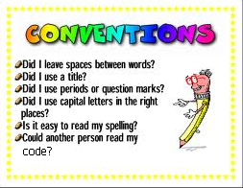
Naming Guidelines for Private Variables (Fields in C#)
Prefix private variables with "_”.
Use camel case as a general rule or uppercase for very small words.
Examples: _firstName, _regNo, isalary.

Slide 13
Naming Guidelines for Local Variables
Use camel case as a general rule or uppercase for very small words.
Examples: strFirstName, strEmployees.

Slide 14
Naming Guidelines for Constants
The names of variables declared class constants should be all uppercase with words separated by underscores.
It is recommended to use a group naming schema.
Examples:
AP_WIN_MIN_WIDTH
AP_WIN_MAX_HIGHT

Slide 15
Naming Interfaces

Slide 16

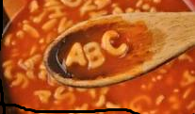
Naming Guidelines for Interfaces
Prefix interface names with the letter "I", to indicate that the type is an interface.
Do not use the underscore character (_).
Use pascal case.
Examples: ICloneable, Iformatable.

Slide 17
Smart Programming Considerations
Naming constants in capital will help in identifying them.
Using “I” before every interface name will group them together when listing.

Slide 18
Reference Reading
Note: The links provided here are valid at the time of production of this content. However, web URLs may change from time to time , so users are encouraged to exercise their own judgment in using the information given in the pages referred to by these links

Slide 19
Summary
Naming Convention
Pascal Case
Camel Case
Upper Case

